Slide 1

Financial anaLYSIS :-
Name = Vardhan email = vardhankatrik@gmail.com

Slide 2

introduction
Data set graph & main points
Graph explainnation
Ground anaylises

Slide 3
Data set graph & main points
Mar Cap – Crore – is Market capitalisation , Market capitalisation helps investors assess a company’s size , stability, and risk level
Sale-Qtr (Quarter) - companies typically report their sale and other financial metrics in their quarterly earning reports which are released to shareholders and the public.
Market capitalisation to sale qtr ratio - The Market Capitalization to Sales (MC/Sales) ratio is a financial metric used to evaluate a company's valuation relative to its revenue or sales. It is calculated by dividing the company's market capitalization (total market value of its outstanding shares) by its total sales or revenue over a specified period.

Slide 4
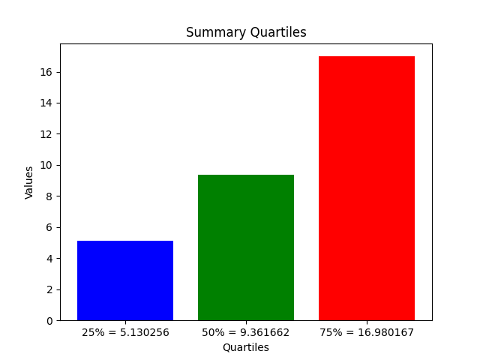
BAR graph ,summary quartiles
In the following graph shows the market capitalisationto sale ratio 25% of 500 company’s fall under 5.130256
This means that investors are valuing the company at approximately 5.13 times its quarterly sales revenue.
Means has moderate return
50% of company’s fall under 9.361662
This means that investors are valuing the company at approximately 9.36 times its quarterly sales revenue.
Means has high returns with risk
75% company’s fall under 16.980167
This means that investors are valuing the company at approximately 16.98 times its quarterly sales revenue.
Means has high returns with high risk ,if company expiation is not meet

Slide 5
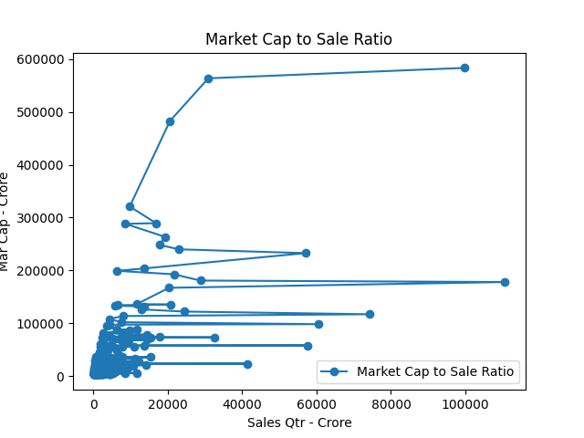
Company’s market cap to sale ratio
This following graph shows another visualization of market cap to sale ratio
Reliance
Natl.Fertilizer

Slide 6
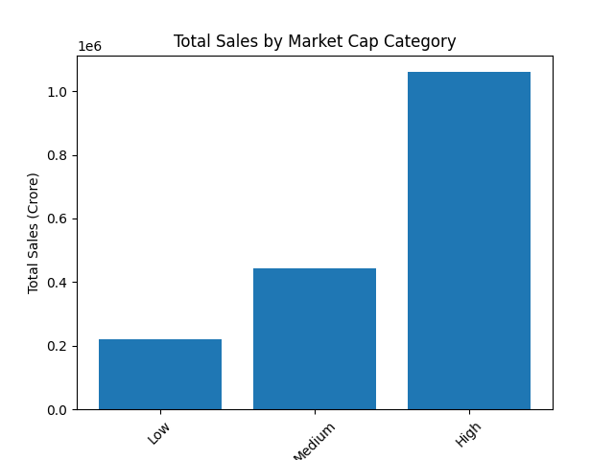
SALES BY MARKET CAP
This bar graph shows the sale visualization of company corresponding to Market cap
The y-axis represents the total sale in crore also shows that almost company’s have done over 1.0 crore sale the sales are represents as low , medium and high

Slide 7
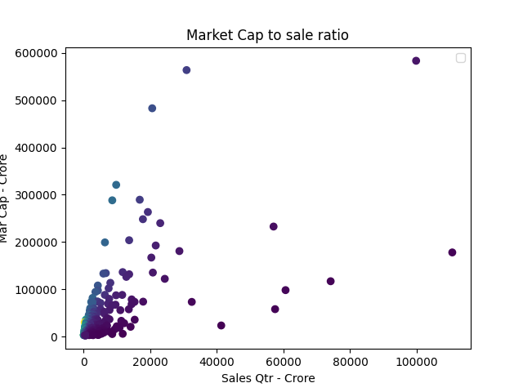
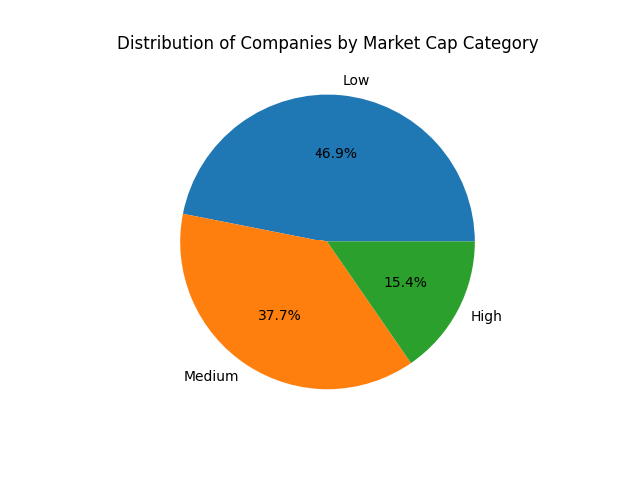
MARKET CAP RATIO AND MARKET CAP CATEGORY ANALYSIS
Shows how many company has high , med, low market cap

Slide 8
Ground analysis MARKET CAP RATIO AND MARKET CAP CATEGORY ANALYSIS
THE following analysis shows how many company promise high returns and risk with their sales and market cap ratio
It is important to analysis market before invest or buying company like [“Reliance”]
Offer high return with moderate risk while other company with less market cap can offer high return but has high risk if company expectation not meet

Slide 9
Thank you

